Slide 1
Welcome to Pure Mathematics 1
2025/09/04
Shi Feng

Slide 2
How is A-level different?
Module-based program designs
Process is just as important as results
International exams in January, May and October
Grade is given on a curve
Final grade consists of performance in every module

Slide 3
What to learn in this semester?
Get used to math in English
Pure mathematics 1 (P1)
Preperation to International exam in January
Starter for P2

Slide 4
Class requirements (All GPA related!)
Be on time for classes
Listen to class lectures deligently
No sleeping (stand up if drowsy)
Be responsive for interactions
Complete homework in time and with qualities

Slide 5
Chapter 1.1: Index Laws
Shi Feng

Slide 6


Exponents
$$a^{n}$$

Slide 7

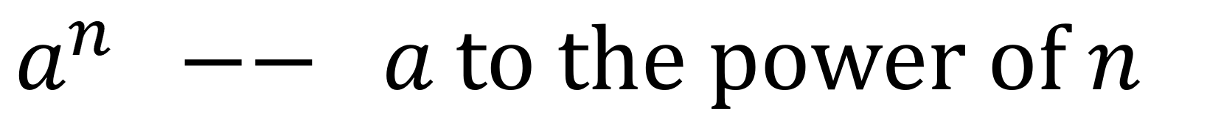
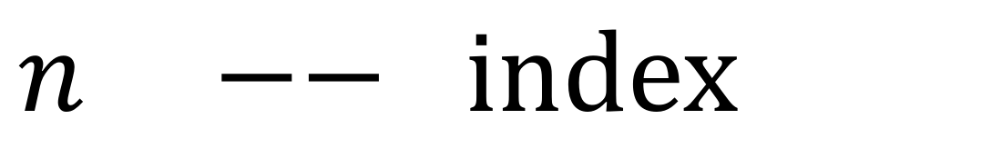
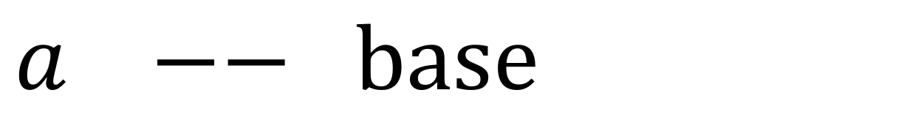

Exponents
$a −−$base
$$a^{n}$$
$n −−$index
$a^{n} −− a$to the power of $n$

Slide 8




Index Laws

Slide 9
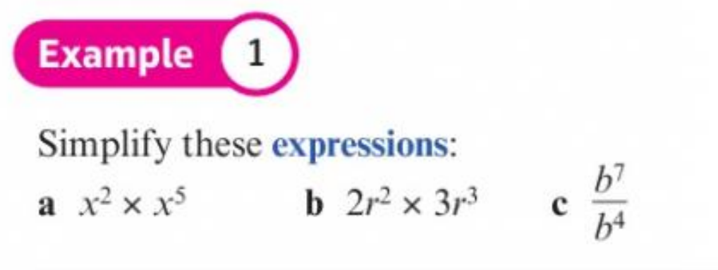
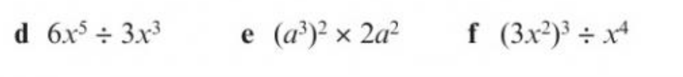
Index Laws

Slide 10

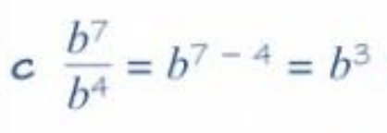
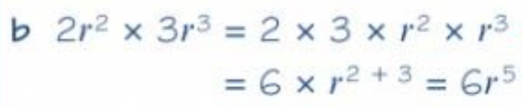
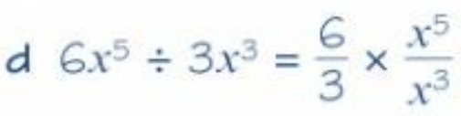

Index Laws

Slide 11

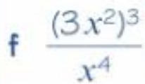
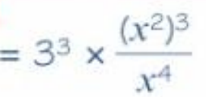

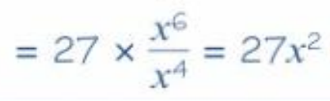
Index Laws

Slide 12
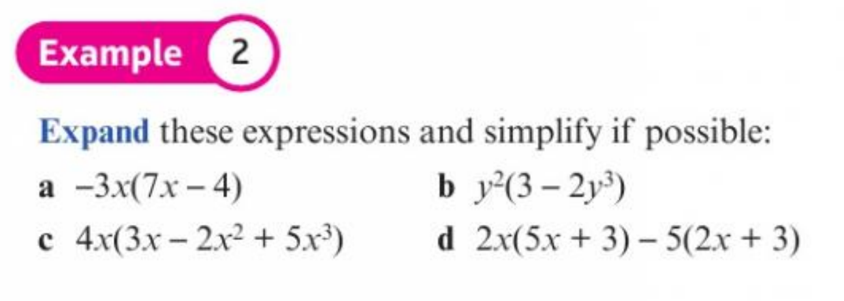
Index Laws

Slide 13
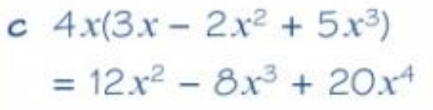
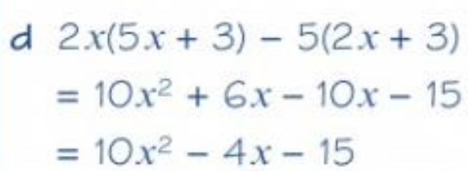


Index Laws

Slide 14
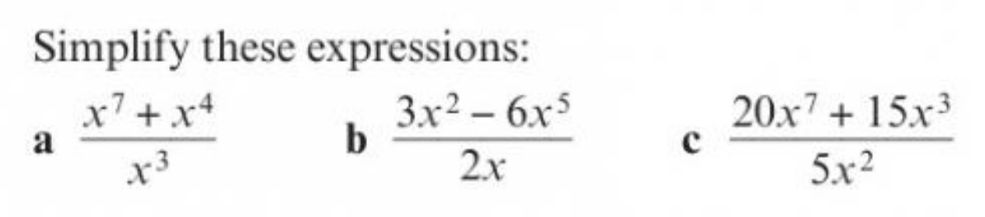
Index Laws

Slide 15
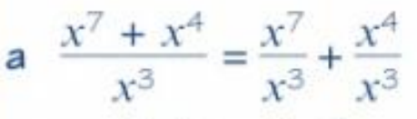
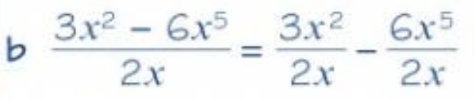

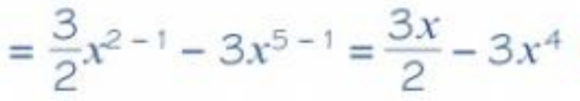
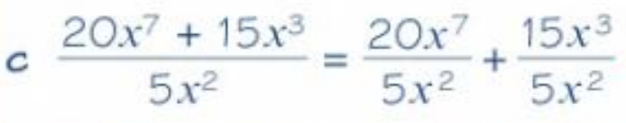
Index Laws

Slide 16
Expanding brackets
1.2

Slide 17
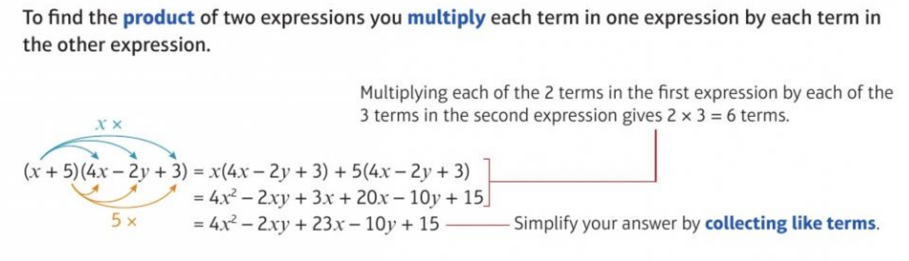
Expanding brackets

Slide 18
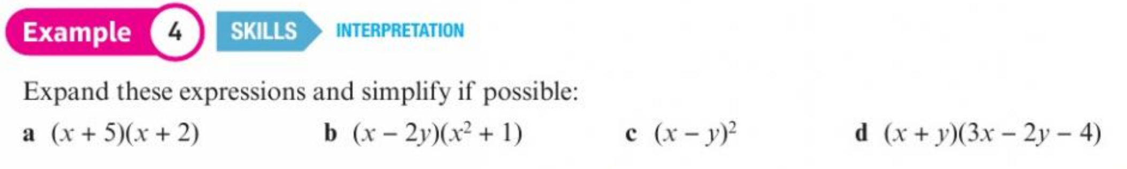
Expanding brackets

Slide 19
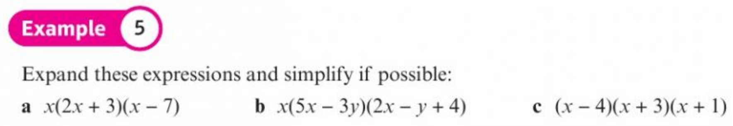
Expanding brackets

Slide 20
Factorising
1.3

Slide 21
Factorising

Slide 22
Factorising

Slide 23
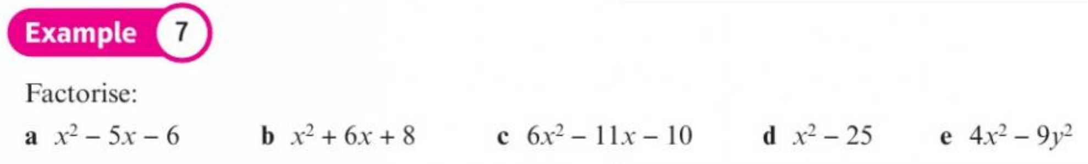
Factorising

